Slide 1
DONATE KART PROBLEM
TABLE NUMBER 16

Slide 2
Problem Description
We have created a Web application which supports three kinds of users: 1. Donors
2. Takers
3. Admin
We have created registration page for all users.
We have created tables to store the data.
Tables – Donor, Taker, Admin, Item, user.

Slide 3
Donor
We have created login page for the donor.
Using id and password, donor will login.
We created a donor table consists of donor’s name, id, email, contact number, address and item_id.

Slide 4
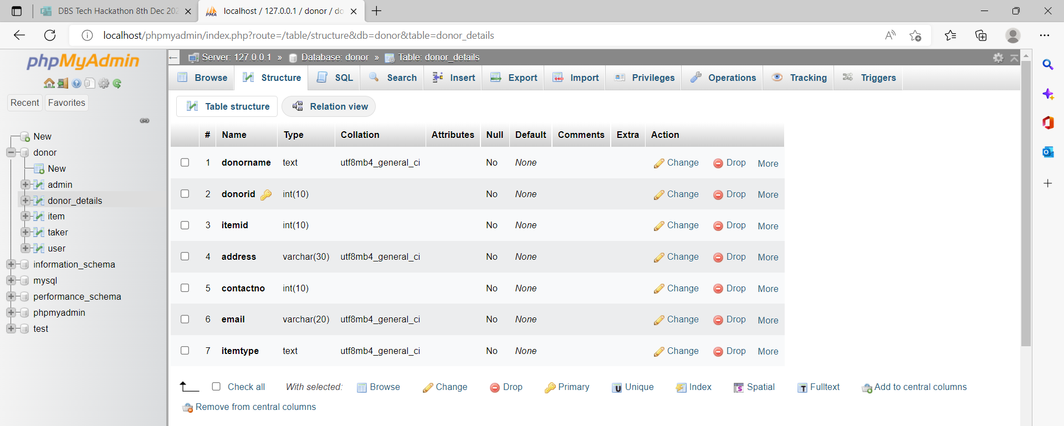
Donor table

Slide 5
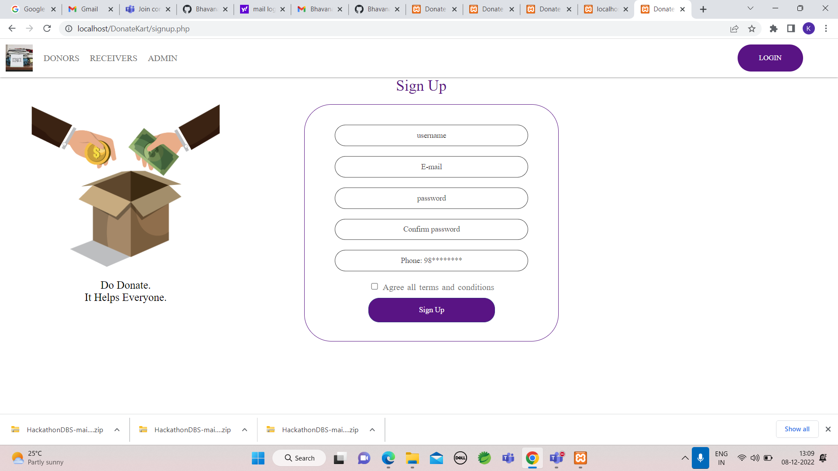

Slide 6
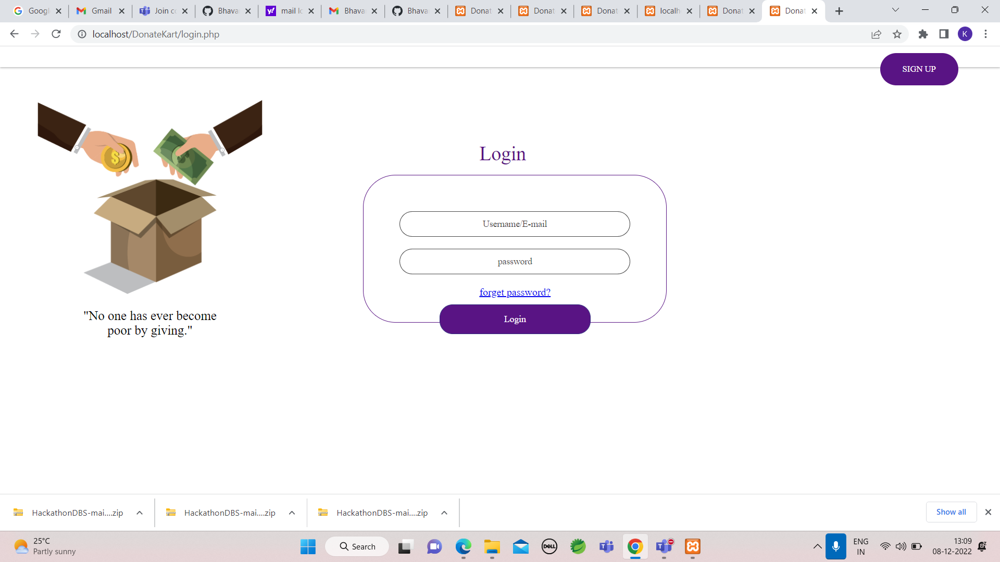

Slide 7
Taker
We created a taker table consists of taker’s name, id, email, contact number, address and item_id.

Slide 8
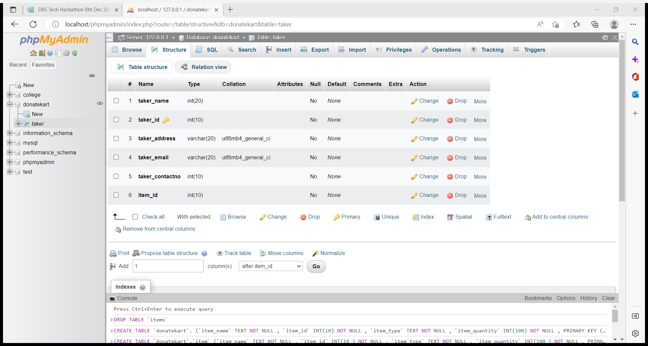
Taker Table

Slide 9
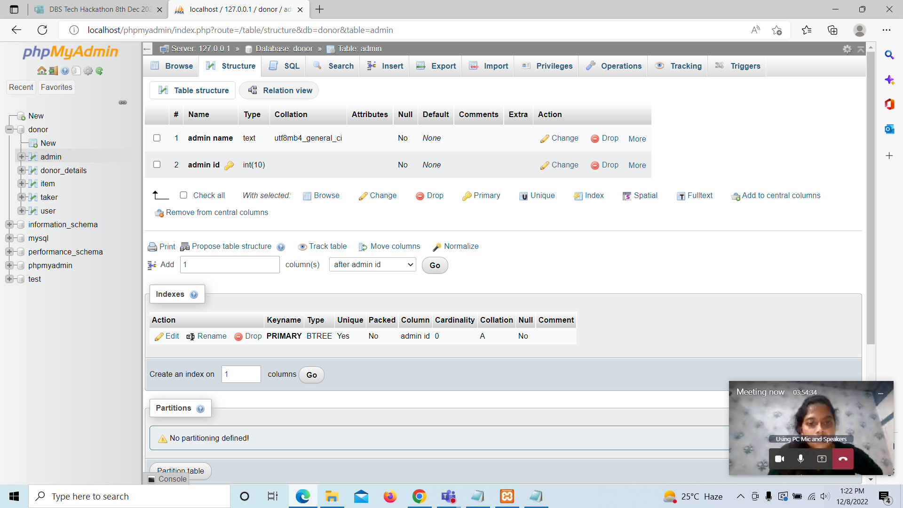
Admin
2 columns- admin_name and admin_id

Slide 10
Technologies used
PHP
MYSQL
LOCALHOST – XAMPP
HTML
CSS
JAVASCRIPT

Slide 11
GitHub - BhavanaVennam/HackathonDBS

